Slide 1
Build your first
Chrome Extension
ING Front End Summit 2020

Slide 2
What to expect / Agenda
Chrome Extension Workshop - IFES 2020
Introduction of different building blocks of Chrome Extension
Build IBAN Generator as Chrome Extension
Q&A / Support

Slide 3
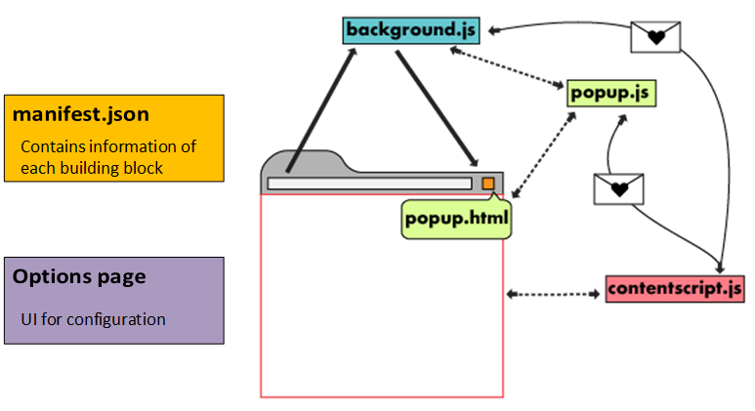
Introduction
Chrome Extension Workshop - IFES 2020

Slide 4
What we are building
Features
Clicking on icon, will generate random IBAN number and copied to clipboard.
Context menu on input fields to fill it with newly generated IBAN number.
Options to configure extension like changing Country and Bank.
Option to disable context menu.
Extension to generate random IBAN numbers

Slide 5



Setup
Slack Channel :
Git Repository : https://git.io/JvKw1
Instructions
You will find icons, styles and some code snippets in help-content folder. You are free to use different resources if you like to.
There is already a solution branch for each phase for your reference.
If you need help, just put sticky note on your laptop.

Slide 6
Phase 1
Features
Generate IBAN on click of icon
Copy generated IBAN to clipboard
Display notification
Technical Points
manifest file
background script
browser action api
event listener
notification api

Slide 7

Break

Slide 8
Phase 2
Features
Paste random IBAN through context menu
Store configuration through settings page
Technical Points
context menu
options page
storage api

Slide 9
Thank you.
Zaid Chauhan / Shanikant Singh

